Slide 1
Modelling Colombian Economy: Stock-Flow Consistent Prototype Growth Model
An adaptation from Yilmaz & Godin (2020).

Slide 2
Some issues about FDI insertion.
Lower household consumption due to lower dividend payments to the households.
Important change in the ownership structure of the firms and banks
Greater income account deficit due to greater dividend payments to the RoW.
Initially, there is an appreciation in nominal exchange rate
Parallel, there is a reduction in government interest payments to the RoW
Lower government deficit (%GDP) and lower Public Debt (%GDP)

Slide 3
Some issues about FDI insertion.
There is an increase in exports (%GDP)
However, there is a depreciation in real exchange rate
Significant trade balance but current account deficit (%GDP)
Imports growth (%GDP) because of Armington exports to imports coefficient
Lower credit rationing
Greater CBL
Despite the imports growth, there is a massive accumulation of FX reserves
Better NIIP
Country Risk does not change

Slide 4
Some issues about parameters calibration.
Parameters related to cross border lending supply are unnecessary because those equations of Benchmark Model were changed in order to simplify the external sector dynamics. Rather, we added a credit rationing mechanism.
2. Some zero restrictions are debatable.
Those parameters are encoded from #34 to #42.
Others parameters are #32, #62, #78
Elasticity of MPC to consume wages, financial income and wealth to real deposit rates. Encoded from #70 to #72.
Portfolio flows arbitrage parameter (#31) and FX loans arbitrage parameter (#79).
Exogenous mark – up (#22) and sensitivity of mark-up to inventories gap (#23).
Exogenous share of households bonds holdings (#74) and sensitivity of households bond holdings to relative returns (#76)

Slide 5
Some issues about parameters calibration.
3. The magnitudes of some parameters are debatable
4. New equations and further modifications do not have parameters calibrated.
Depreciation rate (#25) and autonomous investment (#26).
Percentage of price adjustment firms (#24).
Ratio of government spending to total production (#54).
Tax rate on wages (#56)
Exogenous nominal wages growth (#63)
Average employment rate in wage dynamics (#65)
Scalling parameters in MPCs (encoded from #67 to #69). The problem arises if we assume that there is no sensitivity of MPCs to real deposit rate.

Slide 6
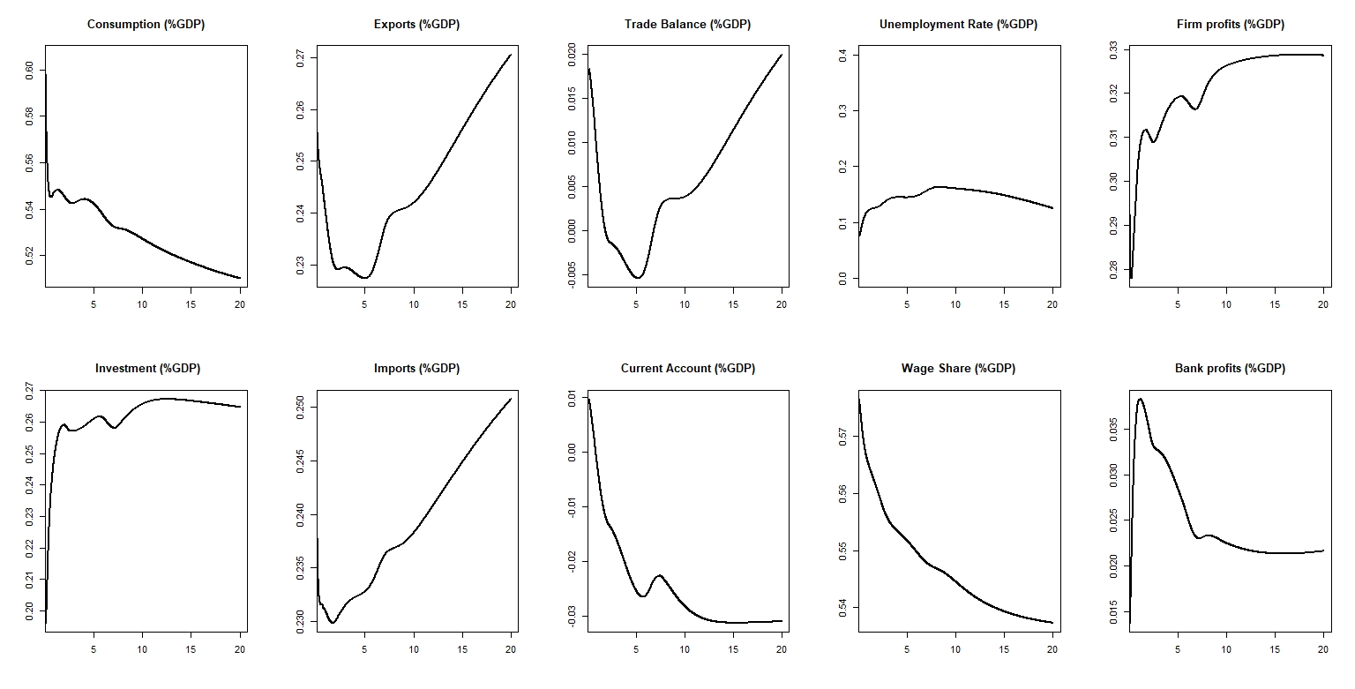

Slide 7
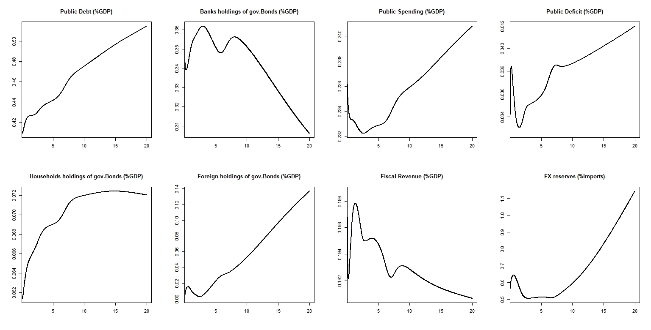

Slide 8
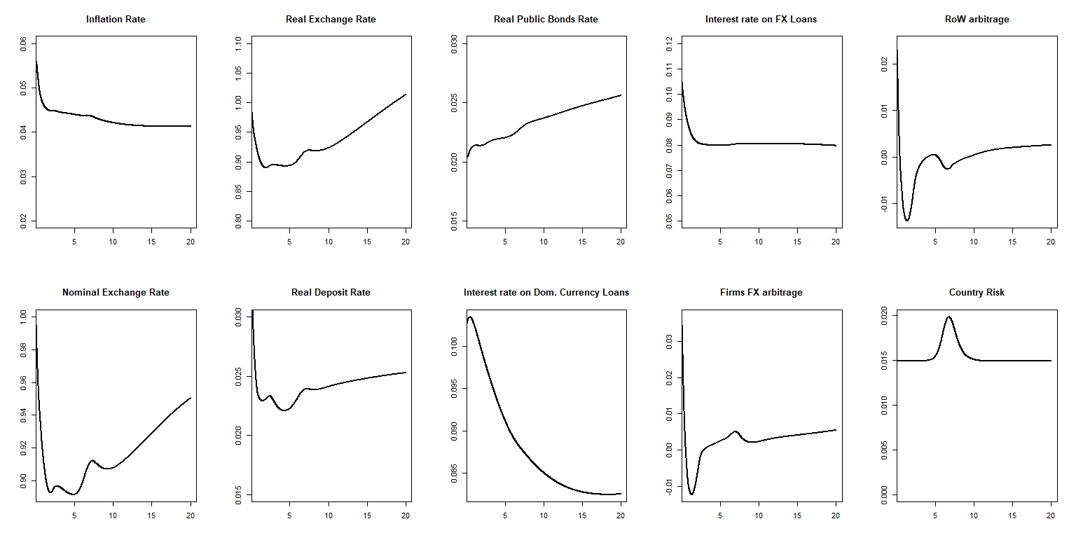

Slide 9
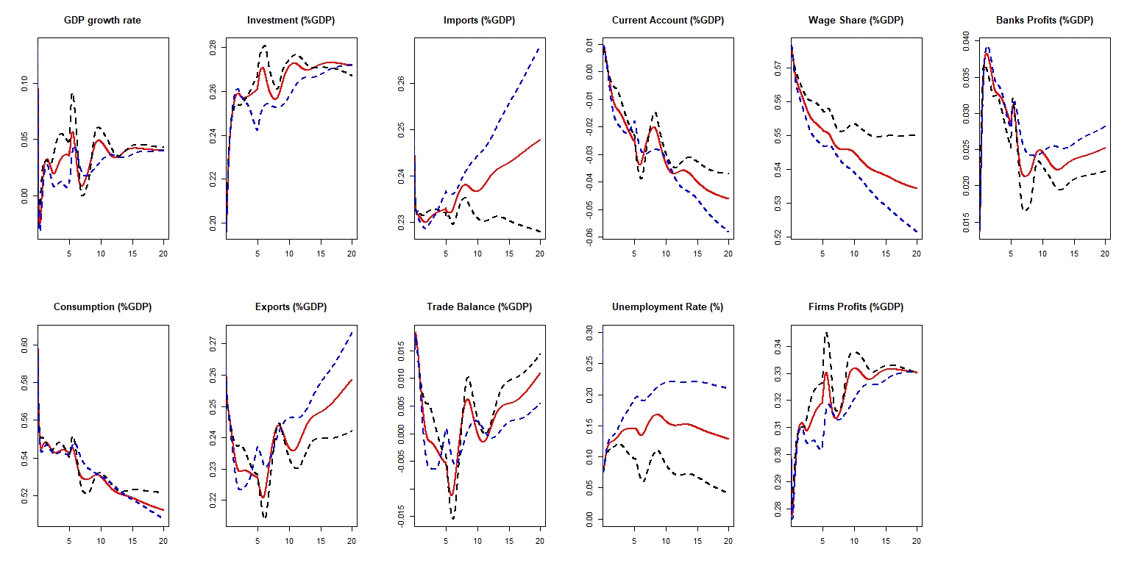

Slide 10
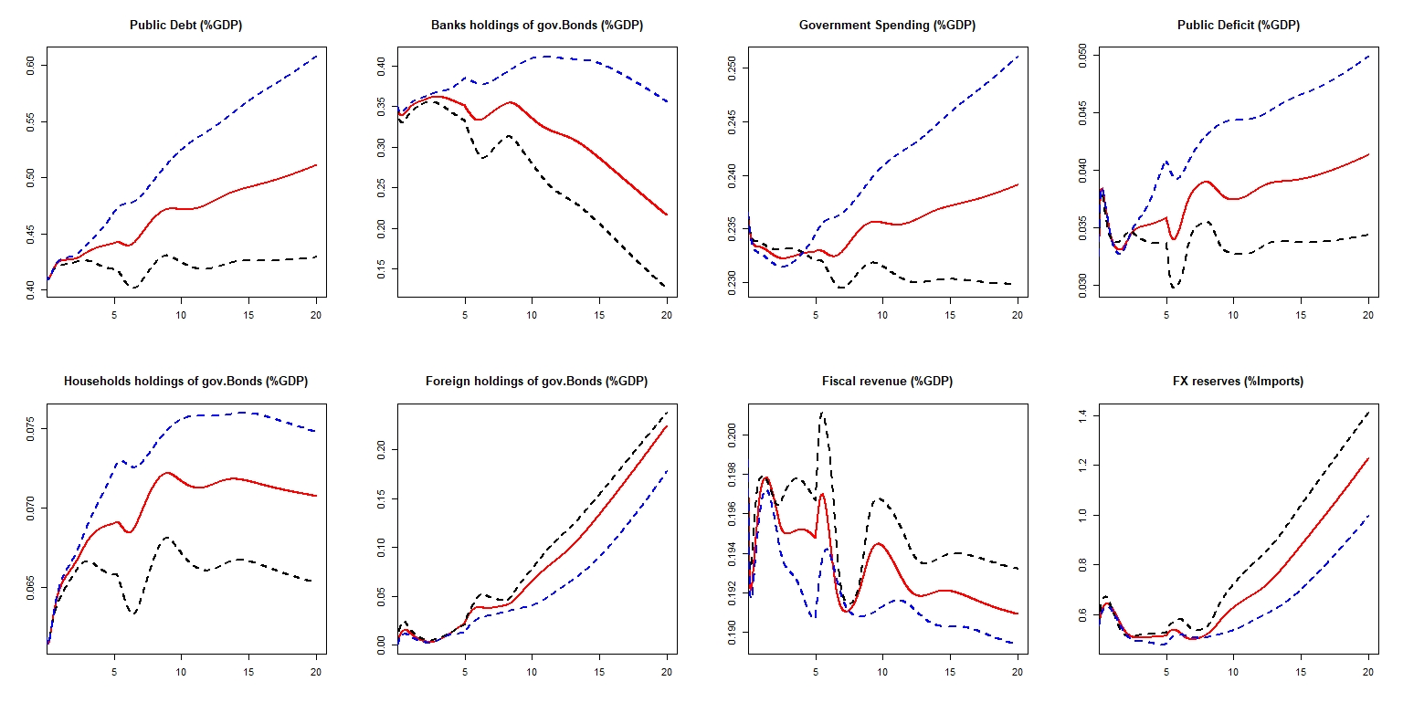

Slide 11
